Slide 1
Ukraine Damage Map
Maciej Kutyła & Tymoteusz Zapała

Slide 2

Table of Contents
Current solutions
Our contribution
Idea
App presentation
Tech stack
Next steps

Slide 3
Current solutions

Slide 4
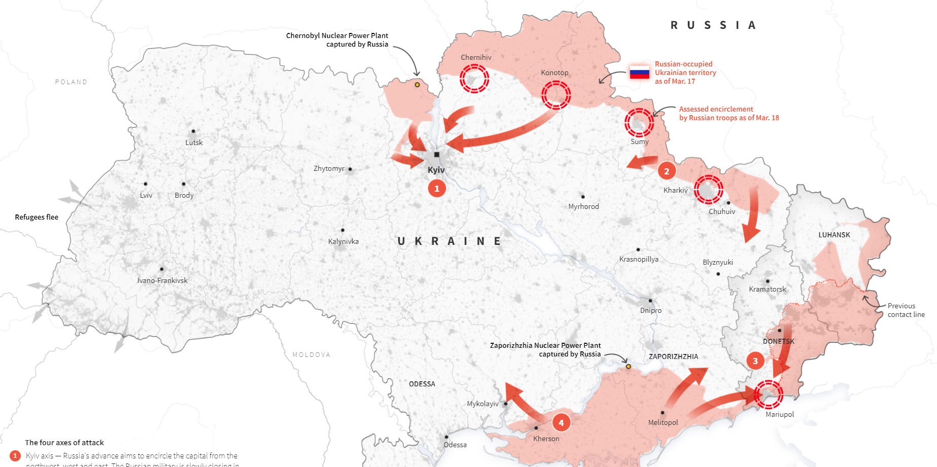
Current solutions - Reuters

Slide 5
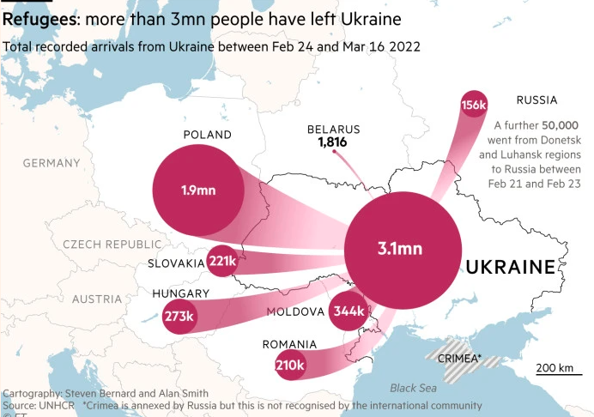
Current solutions - ft.com

Slide 6
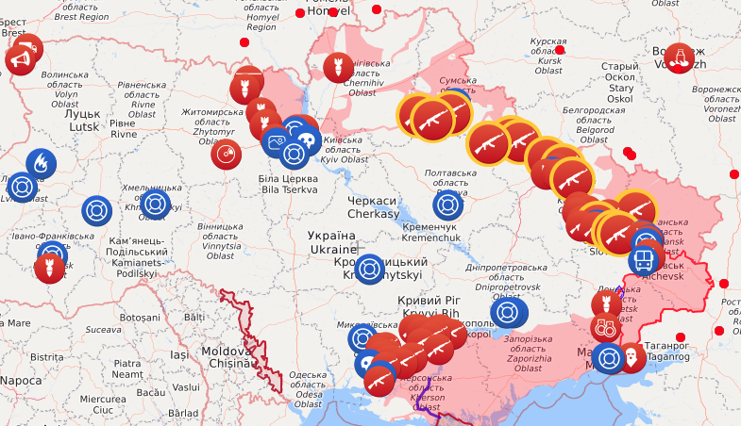
Current solutions - ukrsteam.tv

Slide 7
Our contribution

Slide 8
Our idea
We want to help Ukrainians who stayed in their country;
We want to make their lives easier in these special times;
We want to create something that will be really useful and will be used.

Slide 9


Slide 10
UA Damage Map
We have created a fully functional website (also suitable for use with a telephone) that allows you to report damage degree and thus also determines whether both public buildings and apartment blocks are working. The purpose of the app is to enable residents to spread information quickly and efficiently. You don't know if the nearby post office or hospital is working? Check it out in our app!

Slide 11
App presentation
something serious here

Slide 12
Tech stack
ReactJs, NestJs
Docker
Heroku
REST Api
JS & TypeScript
Github (over 24 commits in 24 hours)
Lots of JS libraries (mainly react-map-gl)
Two developers and one cat

Slide 13


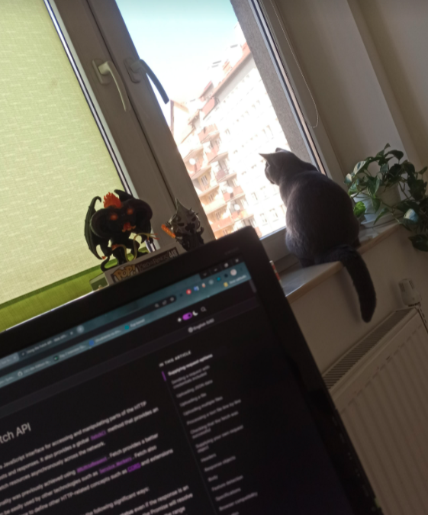

Slide 14
Next steps

Slide 15
Next steps
PWA application → available on all platforms;
push notifications → always be up to date;
admin panel → reports validation;
adding images → to better verification
more complicated algorithms for similar building searching

Slide 16
Thank you for attention and this great adventure!

